Slide 1

Kabani Logistics
Fleet Management Solution
Requirement / UI Wireframe
- Prepared By : Hashint Technologies Pvt. Ltd.
* Document is for requirement capturing. Doesn’t represent the actual graphical interface

Slide 2


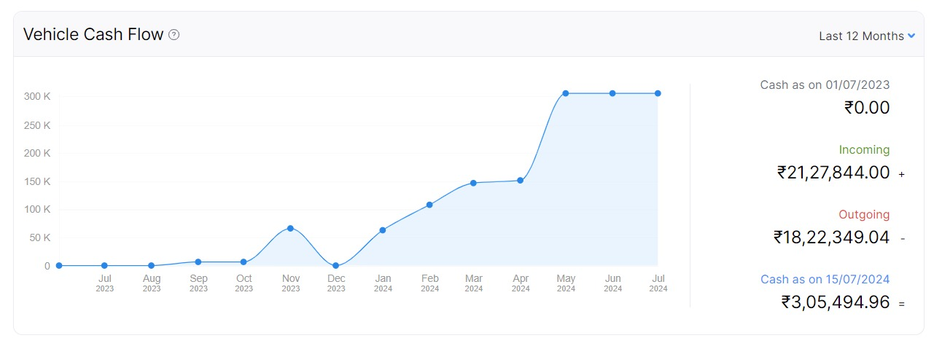
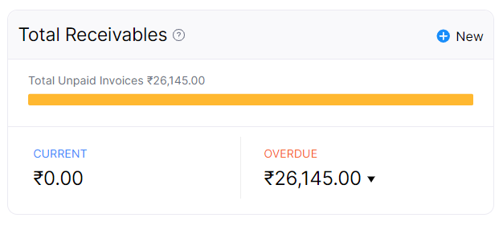
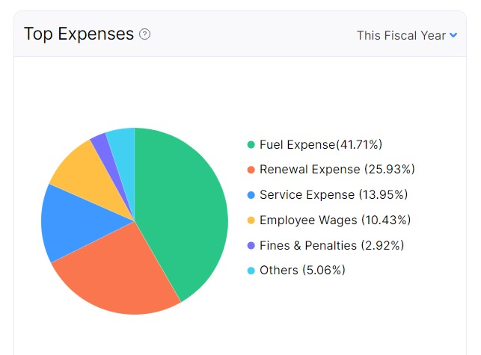
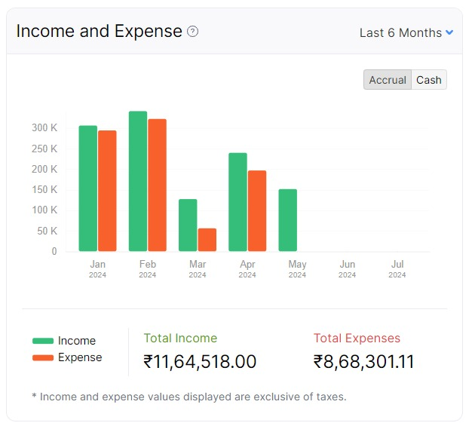
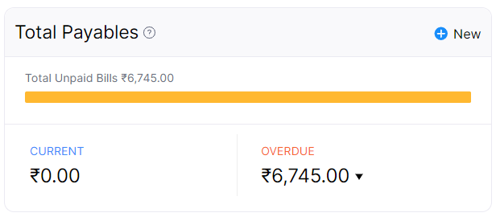
Dashboard |
Fleet Management Dashboard
Kabani Logistics
Vehicles
124 Active
Renewals
TOCKEN OPEN
12
135
Vehicles
3 Dead
Trips
2 Needs Change
7 Insurance
3 Fitness
4 Tax
6 Pollution
1 Permit
VEHICLE REQUEST
04
Requests
6 At Workshop
2 Expired
0 Expired
0 Expired
3 Expired
1 Expired
SPARE PO
04
Service Request
ACCIDENT CLAIM
02
Vehicle Request
LEGAL CASE
04
Renewals
NEW VEHICLE (BM)
04
Job Card
BLACKLIST
04
Workshop
SCRAP VALUE
4500
Purchase
Fuel Tracking
Employees
Others

Slide 3
Menu Links |
Fleet Management Dashboard
Kabani Logistics
Vehicles
Renewals
Job Card
Trips
Requests
Vehicles
Schedule
Job Card
Trips
Service Request
Service History
Reminders
Driver Wage
Vehicle Request
Vehicle Rent
Workshop
Purchase
Employees
Fuel Tracking
Others
Bay Status
Vendors
Driver Allocation
Fuel Entry
Insurance Claims
Stock Inventory
Attendance
Mileage Report
Fines (MVD)
Expense
Driver Behaviour
Legal Follow-up
Purchase Orders
Warranty Tracker
Payments Made
File management
Menu
Sub Menu

Slide 4

Menu Links |
Vehicles > Vehicles
Kabani Logistics
KL 57 N 377| Private
KL 10 AR 9385
Sales
Registration Number | KL 57 N 377
Plate Name | KL 57 N 377 Pick Up
Status | Active
Ownership | Private
Category | LCV
Model | AL – Dost
Chassis Number | MA3ERLF1S00356835GE
Branch | Engapuzha
Asset Value
Registration | 11-06-2019
Delivery | 11-06-2019
Insurance | 07-11-2025
Fitness | 11-06-2029
Tax | 15-03-2030
Permit | 04-05-2025
Pollution | 22-12-2024
GPS | 22-12-2024
Vehicle Age
Average Mileage | 9 Km/L
KL 57 N 377
Private
KL 53 B 7322
Heavy Commercial
KL 14 AE 5874
Rented
Hashtrace GPS Tracking > Menu
Live Track
Route History
Idle Report
Trip Summary
Over Speed
Stop Report

Slide 5
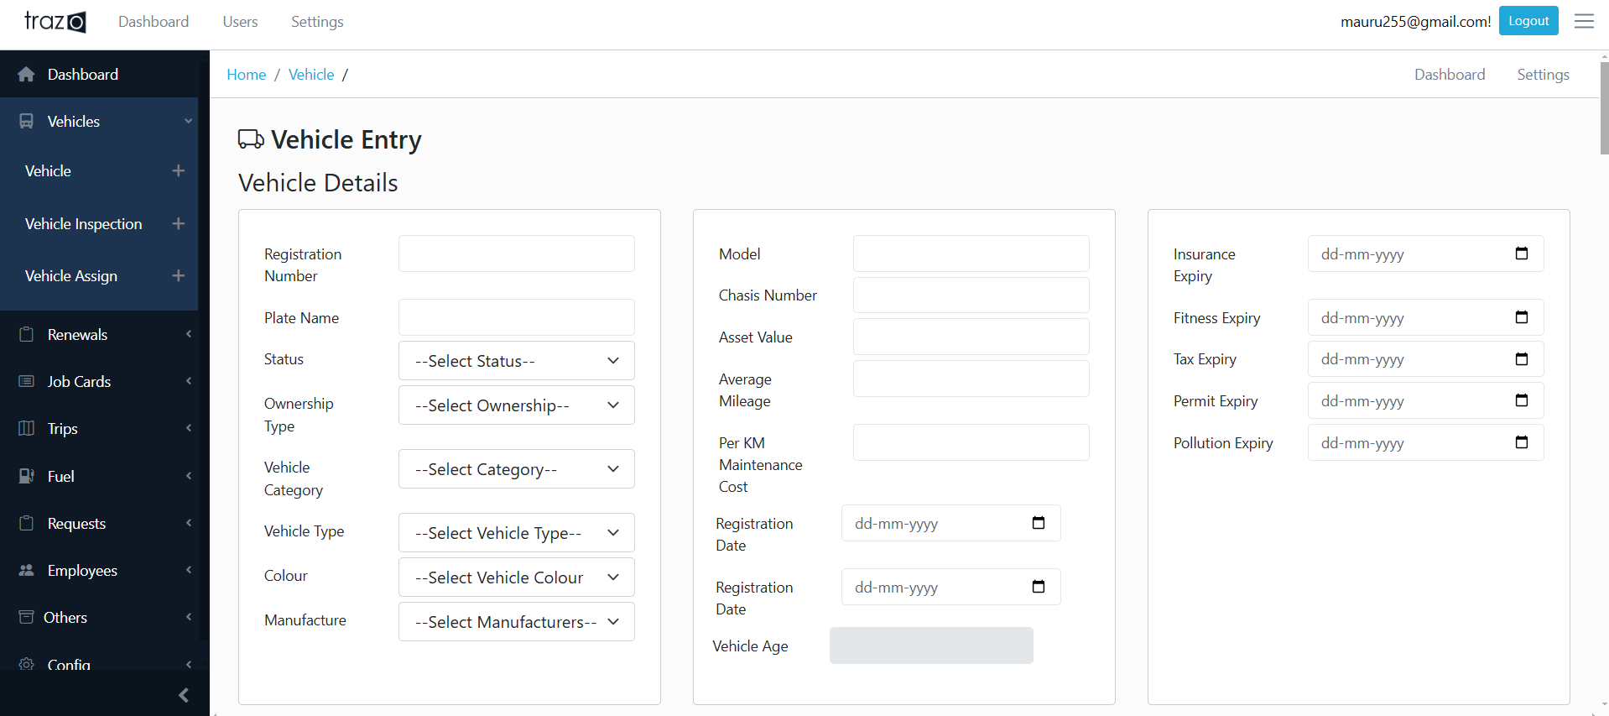
Menu Links |
Vehicles > Vehicles
Kabani Logistics
Vehicle add – asset value (ledger)
Add this field. It will be used to compare actual maintenance cost to total KM cost and identify whether a vehicle is incurring more cost on maintenance.
Hashtrace GPS Tracking > Menu
Live Track
Route History
Idle Report
Trip Summary
Over Speed
Stop Report

Slide 6

Menu Links |
Renewals > Reminders
Kabani Logistics
Insurance
Type | Vehicle | Expiry Date | Due Days | Status | Action
Pollution | KL 57 R 6314 | 19-06-2024 | -25 | Expired
Insurance | KL 57 N 377 | 25-08-2024 | 45 | Active
Pollution | KL 53 B 7322 | 14-09-2024 | 60 | Active
Advertisement | KL 14 AE 5874 | 07-12-2025 | 135 | Active
Pollution | KL 57 R 6314 | 19-06-2024 | -25 | Expired
Insurance | KL 57 N 377 | 25-08-2024 | 45 | Active
Pollution | KL 53 B 7322 | 14-09-2024 | 60 | Active
Advertisement | KL 14 AE 5874 | 07-12-2025 | 135 | Active
Pollution
Registration
Insurance
Permit
Fitness
Road Tax
Engine Oil Change
Tyre Change
Vehicle Service
Advertisement

Slide 7
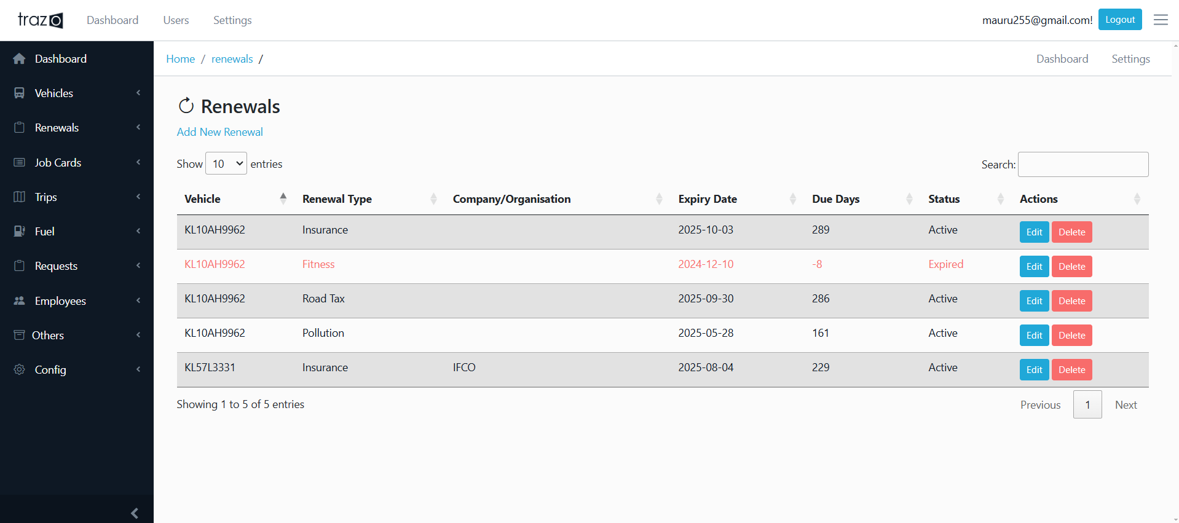
Menu Links |
Renewals > Reminders
Kabani Logistics
Remarks

Slide 8
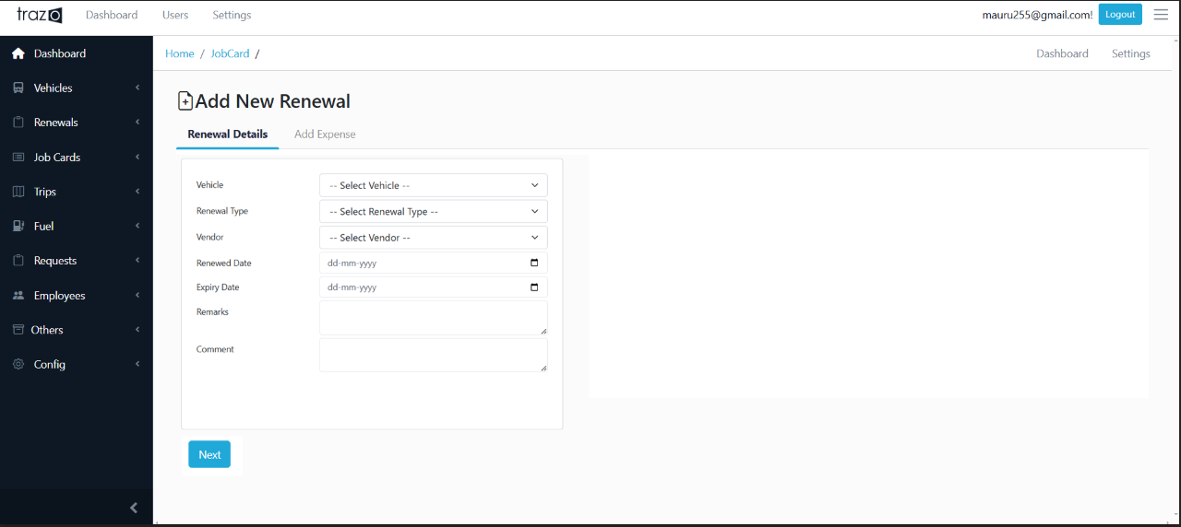
Menu Links |
Renewals > Add New
Kabani Logistics

Slide 9
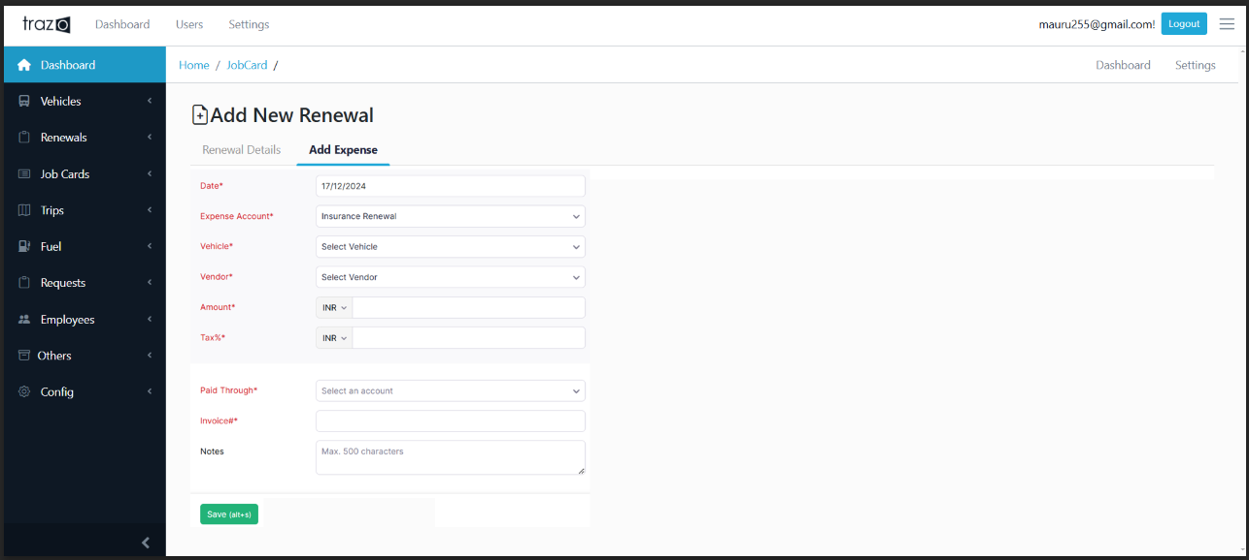
Menu Links |
Renewals > Add Expense Details
Kabani Logistics
Document Renewal expense should be calculated per vehicle on monthly basis. For Eg: If insurance renewal for 1 year is done for 12000. It should be accounted against a vehicle as 1000/ month.

Slide 10
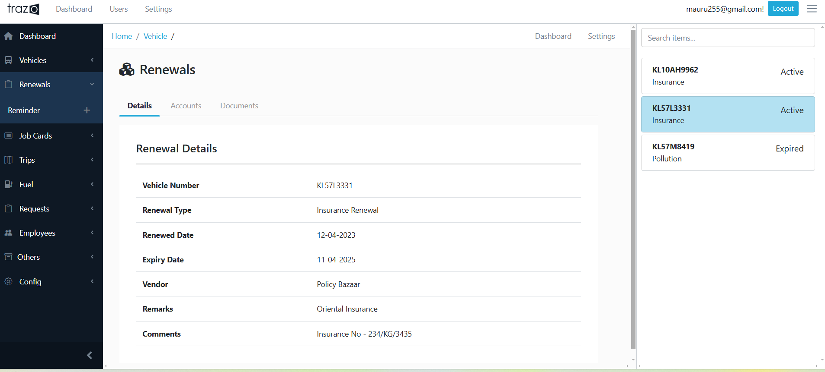
Menu Links |
Renewals > Details
Kabani Logistics

Slide 11
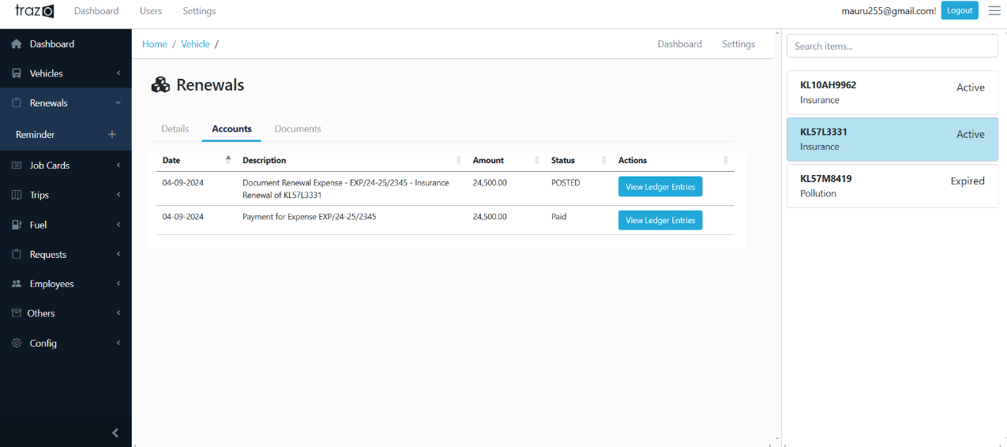
Menu Links |
Renewals > Transaction
Kabani Logistics

Slide 12




Menu Links |
Job Cards > View
Kabani Logistics
Search
 | Date | Job Card # | Vehicle | Service Centre | Type | Odometer | Amount | Action
 | 13-07-2024 | 003372 | KL 57 R 6314 | Calicut Automobiles | Break Complaint | 102153 | 7500 | Details
 | 02-07-2024 | 003371 | KL 57 N 377 | Eram Motors | General Works | 96582 | 15500 | Details
 | 24-06-2024 | 003370 | KL 53 B 7322 | Eram Motors | Periodic Service | 35621 | 23450 | Details
 | 16-06-2024 | 003369 | KL 14 AE 5874 | Calicut Automobiles | Accident | 15624 | 154550 | Details
 | 07-05-2024 | 003368 | KL 57 R 6314 | Popular Motors | Others | 23154 | 900 | Details
* Export Option with Total Amount

Slide 13
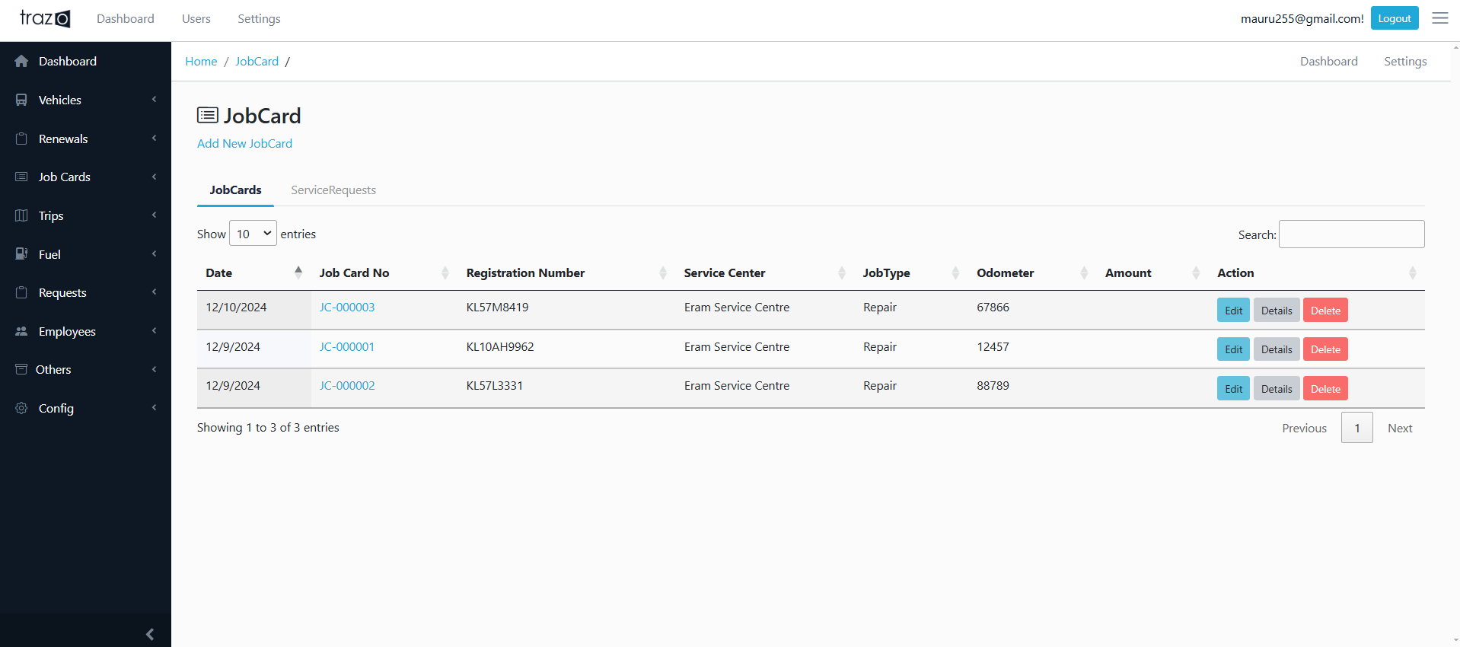
Menu Links |
Job Cards > View
Kabani Logistics
Job Card Closed Date needed. If Job Card is Open, Then Vehicle status is “At Workshop”
* Export Option with Total Amount
Select a Job Card >> Print Option

Slide 14

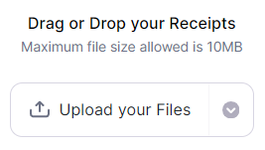
Menu Links |
Job Cards > Details
Kabani Logistics
KL 57 N 377| # 003371
# 003372 | 13-07-2024
KL 53 AE 312
Job Card Number | 003371
Date | 02-07-2024
Odometer | 56324
Branch | Engapuzha
SR Number (Optional)
Service Centre | Eram Motors
Service Type | Periodic Service
Description | Clutch hard so clutch set replaced.
Inspection CL # (Optional)
# 003371 | 02-07-2024
KL 57 N 377
Get Reading from GPS Device
# 003370 | 24-06-2024
KL 53 B 7322
# 003369 | 16-06-2024
KL 56 AE 5847
Details | # 003371
Sl No. | Item | Part Name | Part # | Quantity | Rate | Tax | Amount
1 | Spare | Clutch Set | 409 | 1 | 4650.00 | 5% | 4882.50
2 | Spare | Clutch Release Bearing | 410 | 2 | 780.00 | 5% | 1638.00
TOTAL |  |  |  |  |  |  | 6520.50

Slide 15
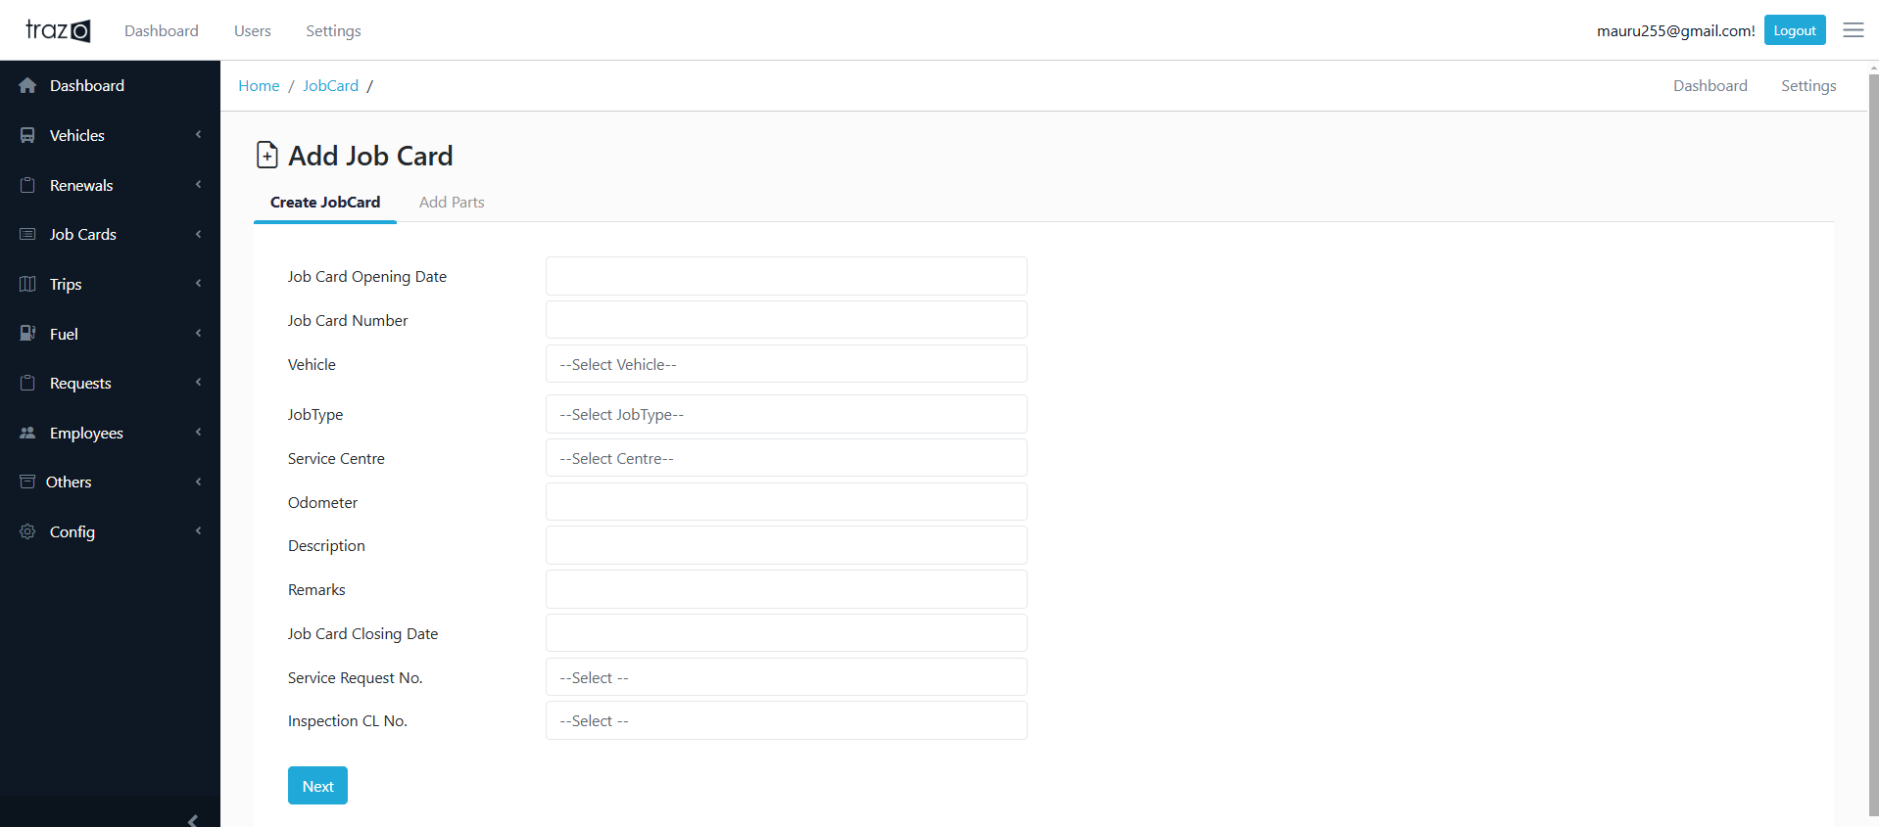
Menu Links |
Job Cards > Add New
Kabani Logistics
If Job Type = Accident Claim,
Insert an entry to Insurance Claim Table
Removed Bay Concept. We will add Company bays as Service Centre itself.
Eg: Engapuzha – Bay 1
Engapuzha – Bay 2 etc..

Slide 16
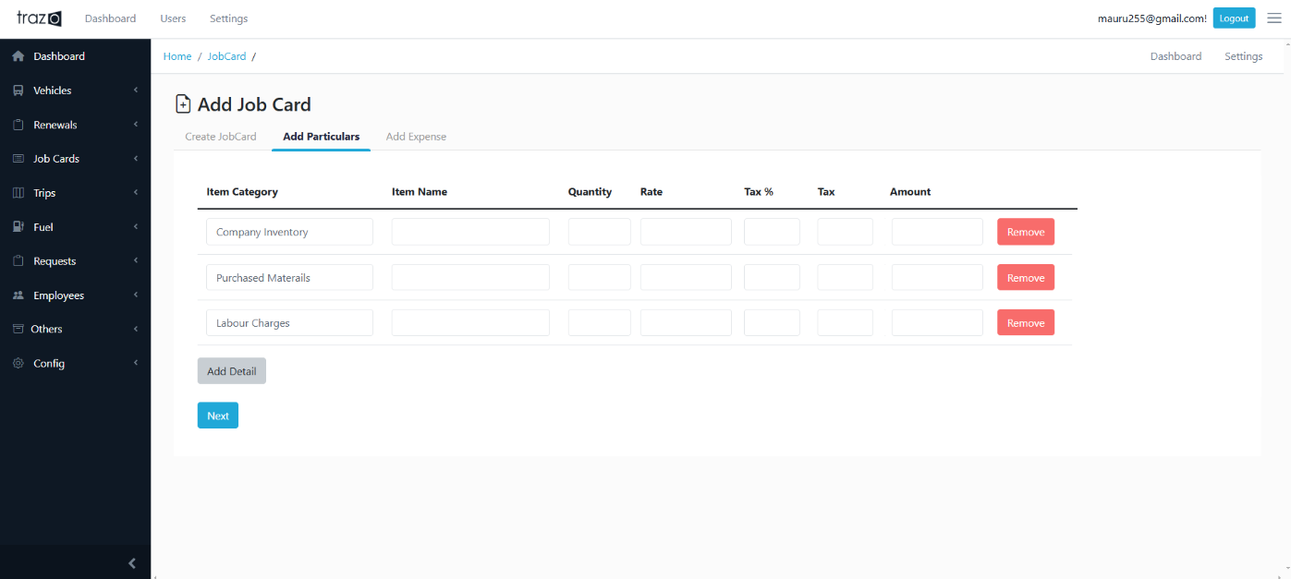
Menu Links |
Job Cards > Add Particulars
Kabani Logistics
If Job Type = Accident Claim,
Insert an entry to Insurance Claim Table
We will add multiple Item Category as in Amvault. Company Inventory for Items purchased from Vendors. Other Item category for items procured from outside or for labour charges from outside workshop

Slide 17
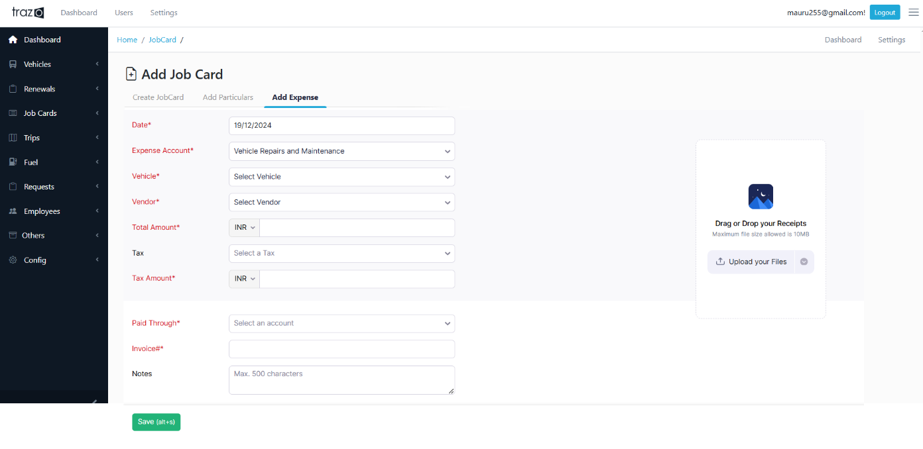
Menu Links |
Job Cards > Add Expense
Kabani Logistics
Need an option to print the Job Card after submitting.
This option is to upload the bill for works done on a vehicle
If the vehicle uses spares from inventory, vendor field will be null while adding expense. Rest everything same.

Slide 18
Menu Links |
Trips > View
Kabani Logistics
KL 57 N 377| # 0560
# 0561 | 13-07-2024
KL 53 AE 312
Trip Number | 00560
Start Date | 02-07-2024
End Date | 04-07-2024
Origin | Engapuzha
Destination | Thrissur
Start KM | 1200
End KM | 1050
Run KM | 150
Driver | Shamsu
Remarks | Prajish – 8086954213
# 0560 | 02-07-2024
KL 57 N 377
# 0559 | 24-06-2024
KL 53 B 7322
# 0558 | 16-06-2024
KL 56 AE 5847
Add Fuel Entry
Add Vehicle Rent
Add Driver Wage

Slide 19
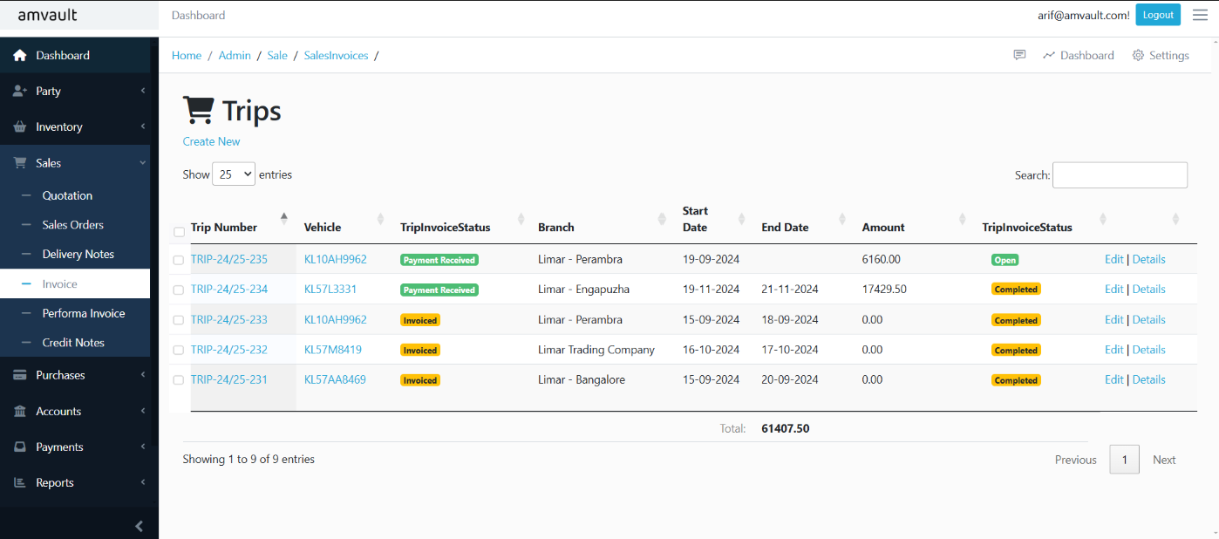
Menu Links |
Trips > View
Kabani Logistics
Select Multiple trips from here and convert to Vehicle rent invoice.

Slide 20
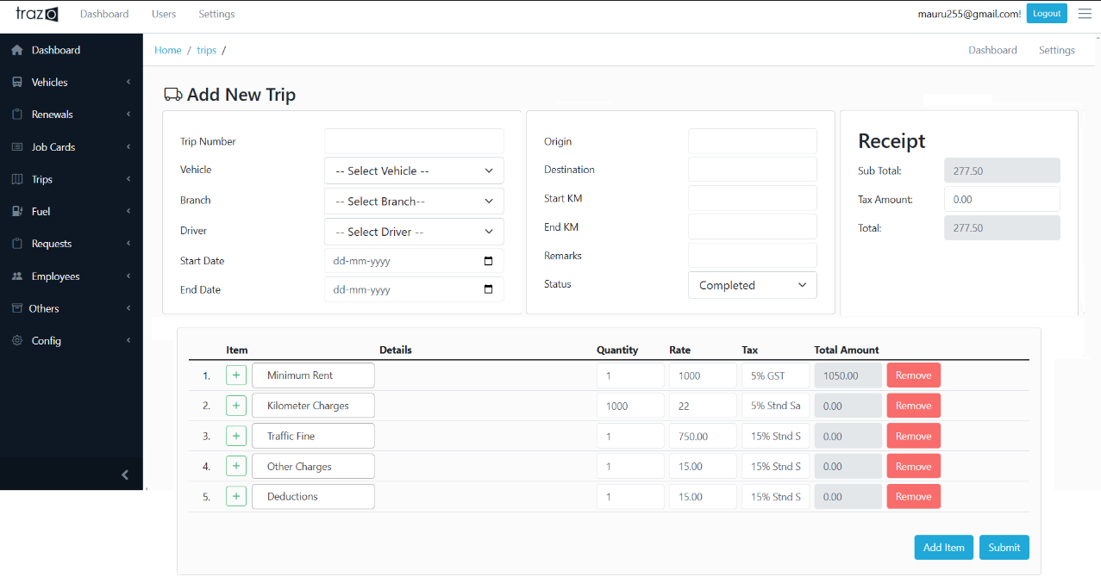
Menu Links |
Trips > Add New
Kabani Logistics
Party Name
Party Bill No
Party Date

Slide 21
Menu Links |
Trips > Driver Wages
Kabani Logistics
KL 57 N 377| # K0067
Details
# K0068 | 13-07-2024
KL 53 AE 312
Slip Number | K0067
Trip Number | 00560
Start Date | 02-07-2024
End Date | 04-07-2024
Origin | Engapuzha
Destination | Thrissur
Start KM | 1200
End KM | 1050
Run KM | 150
Driver | Shamsu
Remarks | 12000 Ton
Fuel | 24221.10
Quantity | 264.46
Sl No. | Particulars | Amount
1 | Loading | 600.00
2 | RTO | 0.00
3 | Repair | 1250.00
4 | Permit | 6700.00
5 | Toll | 0.00
6 | Parking | 200.00
7 | Weight | 150.00
8 | Extra Wages | 0.00
9 | Add Blue | 0.00
TOTAL |  | 8900.00
# K0067 | 02-07-2024
KL 57 N 377
# K0066 | 24-06-2024
KL 53 B 7322
# K0065 | 16-06-2024
KL 56 AE 5847
Party Name
Party Bill No
Party Date

Slide 22
Menu Links |
Trips > Driver Wages
Kabani Logistics
Need to rework this page completely. Particulars added in Driver wages are other expenses related to Kabani.
Plan is to add this page as Trip Expenses.
Add Trip Number for reference if needed.
Add Particulars as in Add Trip Page.

Slide 23
Menu Links |
Trips > Vehicle Rent
Kabani Logistics
KL 57 N 377| # KL24-4-003
Details
# KL24-4-003
13-07-2024
KL 53 AE 312
Bill Number | KL24-4-003
Date | 05-07-2024
Bill To | Engapuzha
Vehicle | KL 57 N 377
Model | AL - Dost
Start Date | 02-07-2024
End Date | 04-07-2024
Start KM | 1500
End KM | 2500
Run KM | 1000
Per KM Charge | 22
Trip Number *
Sl No. | Particulars | Amount
1 | KM Charges | 22000.00
2 | Minimum Rent | 1000.00
3 | Traffic Fine | 500.00
4 | Others | 500.00
5 | Deductions | 0.00
TOTAL |  | 24000.00
Tax (12 %) |  | 2880.00
GRAND TOTAL |  | 26880.00
# KL24-4-002
02-07-2024
KL 57 N 377
# KL24-4-001
30-06-2024
KL 53 AE 312

Slide 24
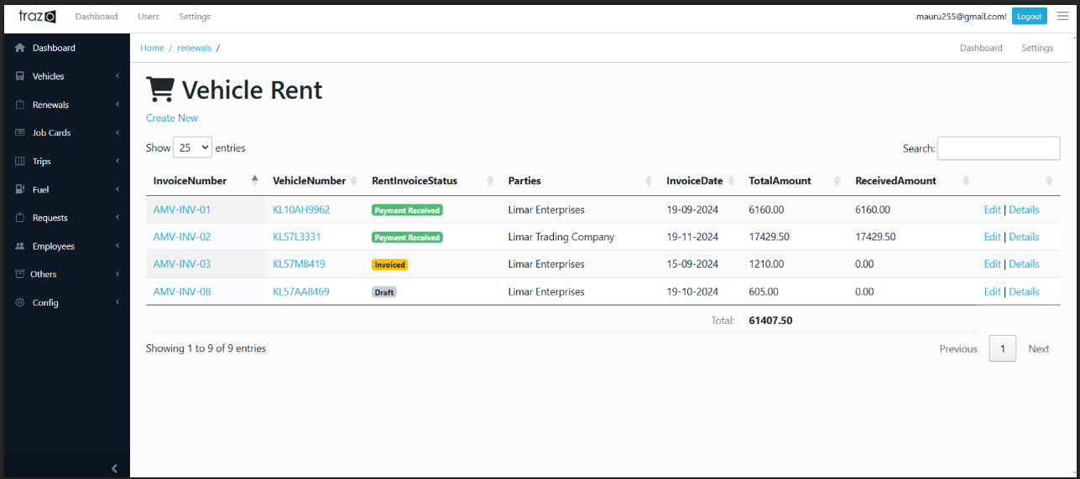
Menu Links |
Trips > Vehicle Rent
Kabani Logistics

Slide 25
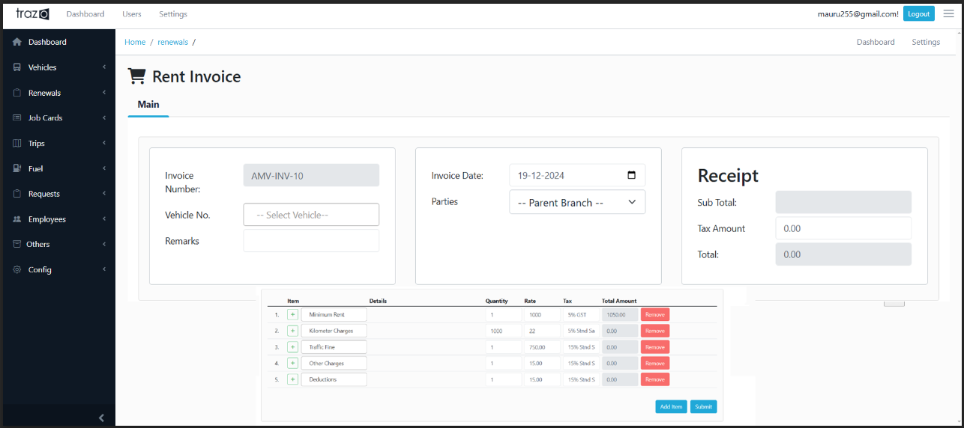
Menu Links |
Trips > Add New Vehicle Rent
Kabani Logistics

Slide 26

Menu Links |
Fuel > Report
Kabani Logistics
Engapuzha
Branch| All
Perambra
Mattannur
Kasaragod
Kottayam
Kaniyampatta
Palakkad
Vehicle | Filling Date | Filling Station | Odometer | Fuel (L) | Amount
KL 57 R 6314 | 13-07-2024 | HP Koduvally | 25648 | 120 | 12000.00
KL 57 N 377 | 25-06-2024 | HP Kannur | 158477 | 60 | 6000.00
KL 57 R 6314 | 01-07-2024 | HP Koduvally | 24362 | 50 | 5000.00
KL 14 AE 5874 | 07-12-2023 | HP Palakkad Town | 9457 | 80 | 8000.00
* Upload Excel Data & Show Total Rows Added and Total Amount

Slide 27
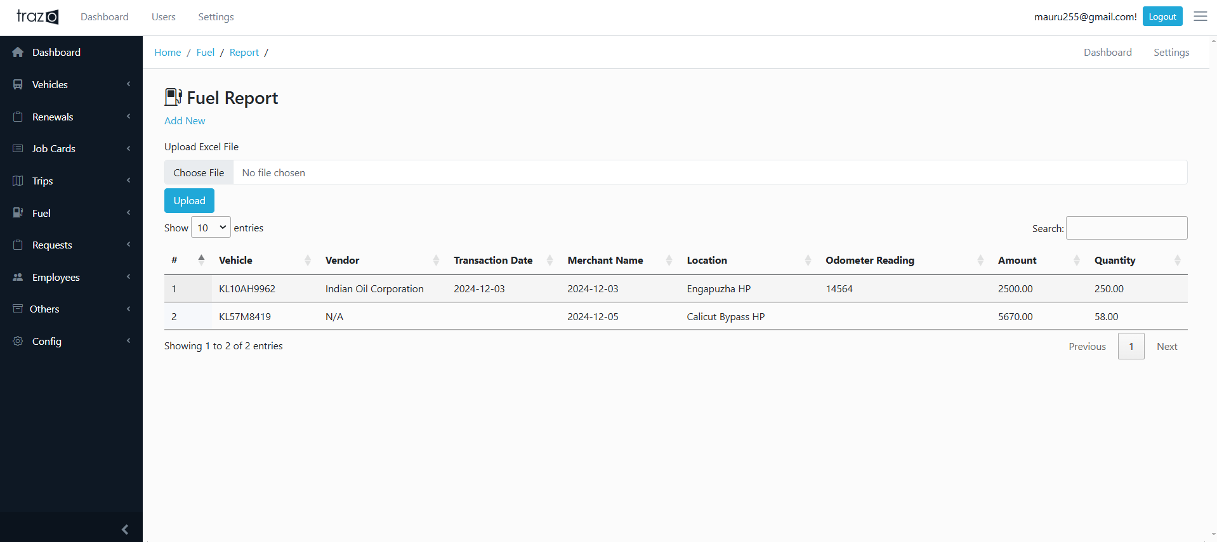
Menu Links |
Fuel > Report
Kabani Logistics
Upload Excel Data & Show Total Rows Added and Total Amount
While uploading data Vendor Name has to be added properly.
Currently they are using IOC cards which is prepaid. They will make payment to vedor and recharge the card. Once this entry is added it should get reflected on vendor balance and also add as an expense on that particular vehicle ( Fuel Expenses)
Also drivers may fill fuel from outside pumps. Need an option to add them directly also.

Slide 28
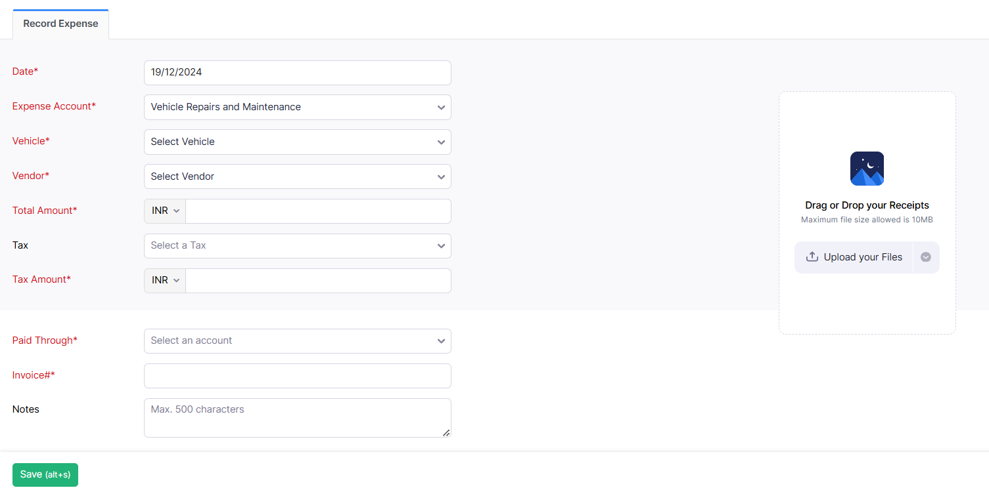
Menu Links |
Others > Record Expense Page
Kabani Logistics

Slide 29
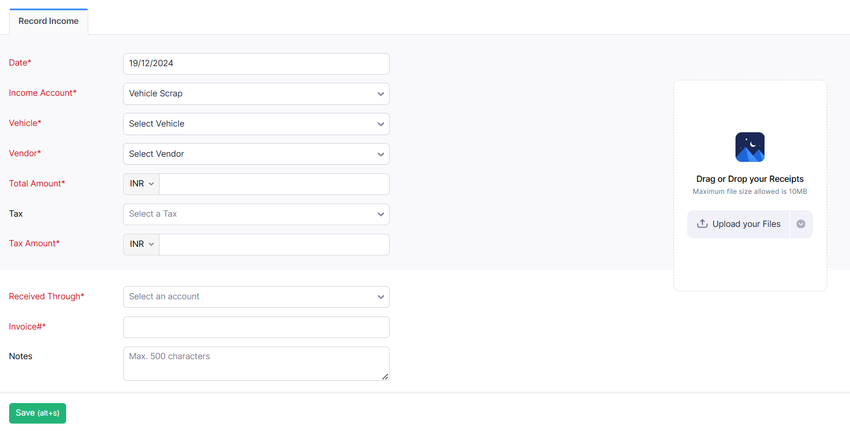
Menu Links |
Others > Record Income Page
Kabani Logistics
When spare parts are given for scrap, or vehicle sold out etc this page is needed

Slide 30
Menu Links |
Requests > Service Request
Kabani Logistics
KL 57 N 377| # SR - 433
# SR - 434 | 13-07-2024
KL 53 AE 312
SR Number | SR- 433
Date | 02-07-2024
Branch | Engapuzha
Status | Open
Origin | Requirement
Remarks | 4 Tyre Request
# SR - 433 | 02-07-2024
KL 57 N 377
# SR - 432 | 24-06-2024
KL 53 B 7322
Service Requests > View
SR No. | Date | Branch | Vehicle | Origin | Status | Remarks | Action from HO | Closed Date
SR - 434 | 13-07-2024 | Kaniyampetta | KL 53 AE 312 | Complaint | Open | Low Pulling Engin..
SR - 433 | 02-07-2024 | Perambra | KL 57 N 377 | Requirement | Open | 4 Tyre Request
SR - 432 | 24-06-2024 | Kasaragod | KL 53 B 7322 | Complaint | Closed | Missing | Ignore | 01-07-2024

Slide 31
Menu Links |
Requests > Vehicle Request
Kabani Logistics
SR - 193787387| 03-03-2024
SR - 193787388
15-07-2024
Type of Vehicle | LMV
Purpose | Pick Load
Capacity
Loading Point
Destination
Date & Time
Status | Open
Requested By
Registration Number | 11-06-2019
Driver Name | 07-11-2025
Mobile Number | 11-06-2029
SR - 193787387
03-03-2024
SR - 193787386
24-02-2024
SR - 193787385
07-01-2024
Vehicle Requests > View
SR No. | Date | Type | Capacity | Origin | Destination | Date & Time | Status | Vehicle | Closed Date | Action
SR-193787388 | 15-07-2024 | Tanker | 20 Box | Engapuzha | Thrissur | 23-08-2024 10:00 AM | Open
SR-193787387 | 03-03-2024 | LMV | 10 Ton | Kasaragod | Palakkad | 08-03-2024 04:00 PM | Allotted | KL 57 M 5623 | 10-03-2024

Slide 32
Menu Links |
Emloyees > Driver Allocation
Kabani Logistics
Engapuzha
Branch| Mattannur
Perambra
Mattannur
Kasaragod
Kottayam
Kaniyampatta
Palakkad
Vehicle | Driver | From Date | To Date | Status | Remarks | Action
KL 57 R 6314 | Gafoor | 13-07-2024 |  | Active
KL 57 N 377 | Ranjith | 25-06-2024 |  | Active
KL 14 AE 5874 | Kalesh | 07-12-2023 |  | Active
KL 57 R 6314 | Shamsu | 01-02-2023 | 12-07-2024 | On Leave | Gafoor Allotted

Slide 33
Menu Links |
Emloyees > Attendance
Kabani Logistics
Engapuzha
Palakkad| April
Perambra
Mattannur
Kasaragod
Kottayam
Kaniyampatta
Palakkad
Name | Designation | Total Working Days | Absent | Remarks | Action
Gafoor | Driver | 26 | 2
Charun | Logistics Manager | 26 | 0
Nawas | IT Support | 26 | 4 | Warning
Vishnu | Driver | 26 | 1
Attendance > Leave History
Date | Branch | Name | Type | Status | Remarks | Approved By | Approved Date
13-04-2024 | Palakkad | Gafoor | Casual | Approved | Family Function | JMD | 13-04-2024
02-04-2024 | Palakkad | Nawas | Casual | Approved | Family Function | JMD | 02-04-2024
01-04-2024 | Palakkad | Gafoor | Sick | Approved | Fever | JMD | 01-04-2024

Slide 34
Menu Links |
Others > Insurance Claims
Kabani Logistics
KL 57 N 377| CM365499
KL 10 AR 9385
NA # | Open
Claim Date | 02-02-2024
Vehicle | KL 57 N 377
Claim Number | CM365499
Expense | 223475.00
Status | Closed
Amount Credited | 127688.00
GST Input | 45227.00
Difference | -50560.00
Credited Date | 11-06-2024
Account Credited | 67108582784
Reference Number | N212170339254875
Insurance Company | Oriental
KL 57 N 377
CM365449 | Closed
KL 53 B 7322
CV120804 | Process
KL 14 AE 5874
CV798813 | Closed
Insurance Claims > View
Vehicle | Claim No. | Claim Date | Expense | Amount Credited | GST Input | Difference | Credited Date | A/c Credited | Action
KL 10 AR 9385 | NA | 15-06-2024 | NA
KL 57 N 377 | CM365449 | 02-02-2024 | 223475.00 | 127688.00 | 45227.00 | -50560.00 | 11-06-2024 | 67108582784

Slide 35
Menu Links |
Others > MVD Fines
Kabani Logistics
Engapuzha
Palakkad| April
Perambra
Mattannur
Kasaragod
Kottayam
Kaniyampatta
Palakkad
Date | Vehicle | Driver | Branch | Offence | Remarks | Amount | Status
13-04-2024 | KL 57 R 6314 | Gafoor | Palakkad | Parking | Kuttipuram | 500 | Not Paid
02-04-2024 | KL 57 N 377 | Nawas | Palakkad | Over Load | Ramanattukara | 2500 | Not Paid
01-04-2024 | KL 14 AE 5874 | Vishnu | Palakkad | Seat Belt | Tirur | 1500 | Paid

Slide 36
Menu Links |
Others > Legal followup
Kabani Logistics
KL 57 N 377| LF 004
KL 10 AR 9385
LF 005 | Open
Date | 02-02-2024
Type | Motor Claim
Sub Type | Damage Liability
Vehicle | KL 57 N 377
Driver | Shamsu
Driver Contact | 9633548181
Status | Closed
Claim Number
Case Number
Description
FIR Number
Court
CNR Number
Advocate
Advocate Contact
Surveyor
Surveyor Contact
Claimed Amount
Settled Amount
Difference Amount
Closed Date
Remarks
KL 57 N 377
LF 004 | Closed
KL 53 B 7322
LF 003 | In Progress
KL 14 AE 5874
LF 002 | Disposed
KL 14 AE 5874
LF 001 | Settled

Slide 37
Menu Links |
Others > Warranty Tracker
Kabani Logistics
Battery
Search
Tyre
Engine
Turbo
# | Item | Vehicle | Purchase Date | Expiry Date | Odometer Start | Odometer Expiry | Serial Number | Bill Number | Vendor | Status
1 | Tyre | KL 57 R 6314 | 19-06-2024 | NA | 46500 | 86500 | TG5687 | 4567 | Spot Wheels | Expired
2 | Engine | KL 57 N 377 | 25-08-2024 |  | 115000 | 125000 |  | 454 | Eram Motors | Active
3 | Battery | KL 53 B 7322 | 14-09-2024 | 13-09-2026 | NA | NA | 2549334 | 5584 | Amaron | Active

Slide 38
Menu Links |
Others > Bay Status
Kabani Logistics
Bay 1
Search
Bay 2
Bay 3
Bay 4
Eram Motors
Mahindra
# | Workshop | Vehicle | Start Date | Closed Date | Job Card # | Supervisor | Remarks | Status
1 | Bay 1 | KL 57 R 6314 | 19-06-2024 |  | 4650 | Manoj | Washing | Open
2 | Eram | KL 57 N 377 | 25-08-2024 |  | 564 | Haris |  | Open
3 | Bay 1 | KL 53 B 7322 | 14-09-2024 | 24-09-2024 | 3564 | Manoj | Repair | Closed

Slide 39
Menu Links |
Vehicle > Vehicle Inspection
Kabani Logistics
KL 57 N 377| # CL001
# K0068 | 13-07-2024
KL 53 AE 312
FRONT BUMBER
FRONT GRILL
RIGHT HEAD LAMP
LEFT HEAD LAMP
RIGHT INDICATOR
LEFT INDICATOR
RIGHT MIRORR
LEFT MIRORR
RIGHT EYE BROW (WHEEL ARCH )
LEFT EYE BROW (WHEEL ARCH )
BONNET
NUMBER PLATE
MAIN GLASS
AIR CUTTER
TOTAL LOGO AND STICKER
RASH DRIVING STICKER
RIGH DOOR OUTER HANDLE
RIGH DOOR INNER HANDLE
RIGHT DOOR WINDER HANDLE
LEFT DOOR WINDER HANDLE
LEFT DOOR OUTER HANDLE
LEFT DOOR INNER HANDLE
DOOR STRAP
WIPPER SWITCH
WIPPER BLADE
HORN
HORN SWITCH
INDICATOR SWITCH
HEAD LIGHT SWITCH
STEERING WHEEL CONDITION
GEAR LEVER BOOT
DRIVER SEAT
CO-DRIVER SEAT
SEAT BELT RH/LH
GLOVE BOX
FRONT RIGHT TYRE
FRONT LEFT TYRE
REAR RIGHT TYRE
REAR LEFT TYRE
SPARE WHEEL
SPARE WHEEL CARRIER
JACKY
WHEEL SPANNER
ENGINE OIL
AIR FILTTER
BATTERY WATER
BATTERY CLAMP
BRAKE FLUID
CLUTCH FLUID
POWER STEERING FLUID
COOLANT
ADD BLUE
FUEL FILTER
FUEL PUMP
FUSE BOX
RELAY
WIRE HARNES
RADIATOR
FAN
ALTERNATOR/ POWER STEERING BELT
# K0067 | 02-07-2024
KL 57 N 377
# K0066 | 24-06-2024
KL 53 B 7322
# K0065 | 16-06-2024
KL 56 AE 5847
* Add Remarks, Date, Inspector Name, Odometer

Slide 40
Billing integration

Slide 41
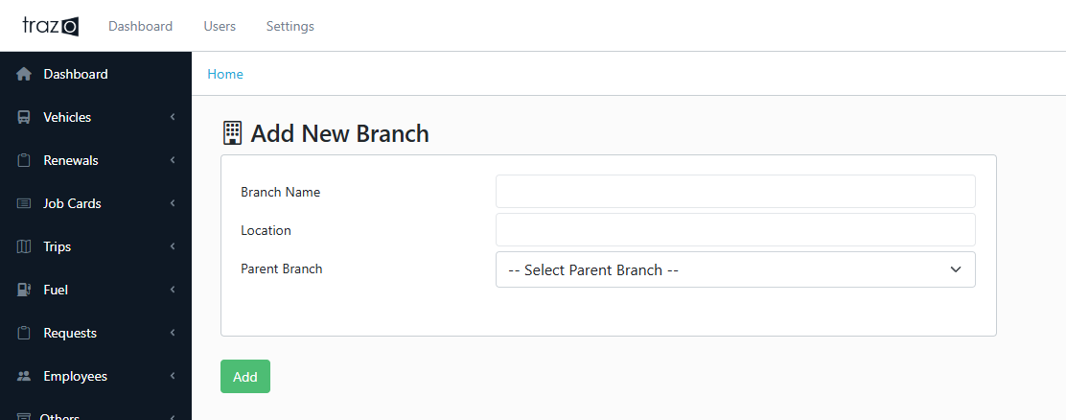
Menu Links |
Customers/ Branches
Kabani Logistics
Customers are actually branches here
Eg:
BranchA (assumed business model)
- BranchA1 (GSTA1)
- BranchA2 (GSTA1)
XYZ (facility only to bill on XYZ) (they may choose to add as parent separately)
- XZYBranchB1 (GSTB1)
- XZYBranchB2 (GSTB2)
*GST of branch has nothing to do with Kabani business
GST of branch is just a text
Branch Login just shows branch specific service request
, other workflows.
+ some reports
BranchA1 (GSTA1) - BranchA2 (GSTA1) has no relation even if they have same GST
@nawas to confirm

Slide 42
Menu Links |
Others > Insurance Claims
Kabani Logistics
+ Payment related
Kabani (company)
..
..
(Limar Etp)Parent Branch
..
….
BranchA
3 kinds of High level roles
Though we have parent branch facilitating any number of levels
In this business we assume only 3 levels and 3 separate High level Roles

Slide 43
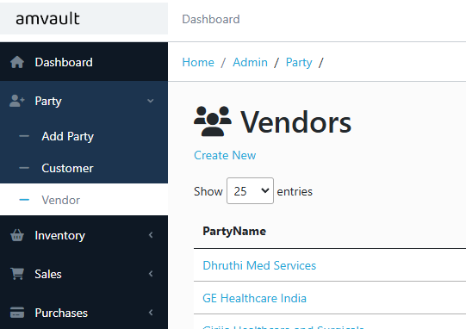
Menu Links |
Vendor
Kabani Logistics
Vendor addition → AS IS Amvault

Slide 44
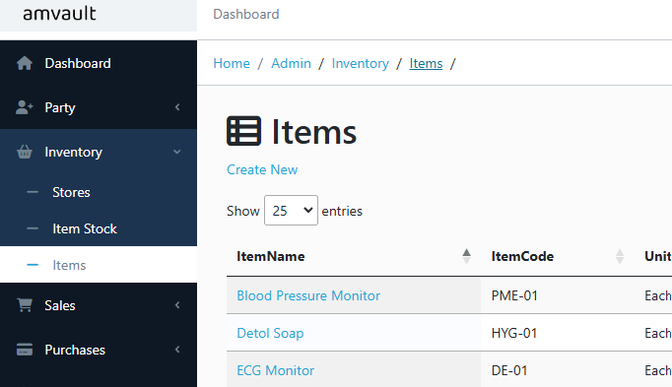
Menu Links |
Items
Kabani Logistics
Item → AS IS Amvault
Remove some of the fields (hide based on associate?)
List unwanted attributes

Slide 45
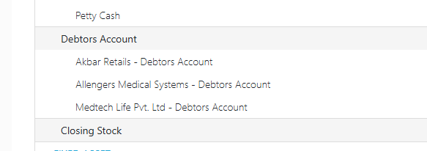
Menu Links |
Ledgers
Kabani Logistics
Debtors account for only parent branch
Sub branch is just additional reference (based on assumption that single GST business model)
Each Sub branch has debtors account
Parent is just a reference

Slide 46
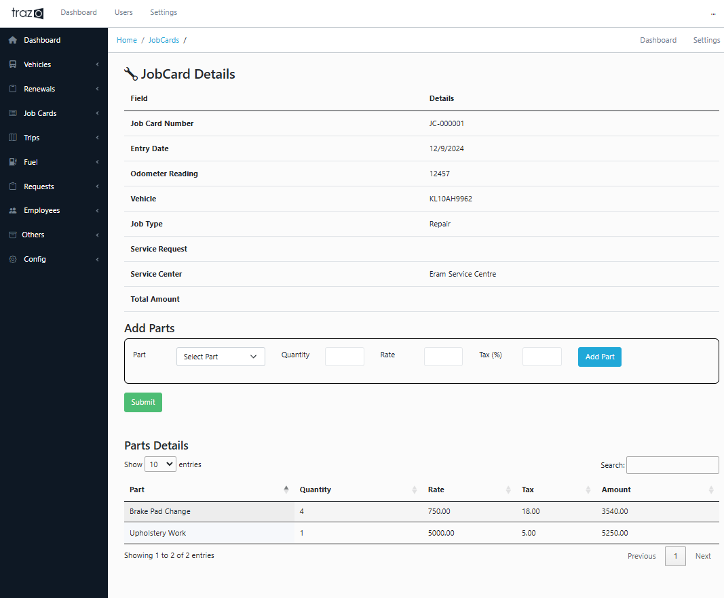
Menu Links |
Job Cards > Details
Kabani Logistics
Add Job Type : Accident Claim
(This entry should list on Insurance Claim Page)
Add Job Card Closed Date. If Job Card Status is open, it means that particular vehicle is at workshop.
Need this
Removed Bay Concept. Adding Bay as Service Centre – Bay Name

Slide 47
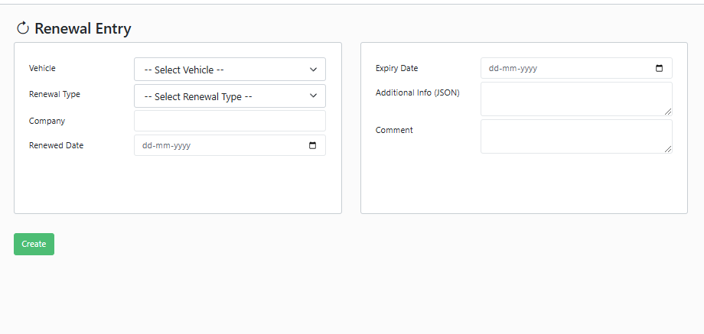
Menu Links |
Others > Insurance Claims
Kabani Logistics
If GPS
-------------------------------
All GPS should be tracked and report should come
What Ledger???
GPS vendors surely needs Creditors account
Payable should be tracked with that ledger
If Insurance
-------------------------------
All issuance should be tracked and report should come
What Ledger???
If Bajaj → Creditors account

